Slide 1



SQL project on pizza sales

Slide 2
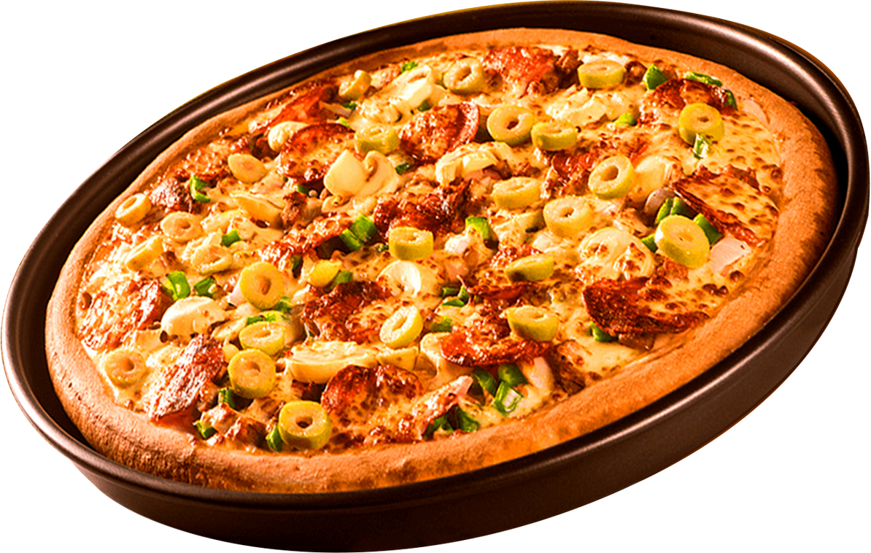

Hell0!
In this project, I utilized SQL to analyze a pizza sales dataset, addressing various business questions. The analysis involved retrieving total orders placed, calculating total revenue, identifying the highest-priced and most popular pizzas, and determining the distribution of orders by hour. Additionally, I joined multiple tables to analyze category-wise pizza sales, calculate average daily orders, and determine the top pizza types based on revenue, both overall and by category.
NAME - MANAS RANJAN BHUI
COURSE - DATA ANALYST

Slide 3
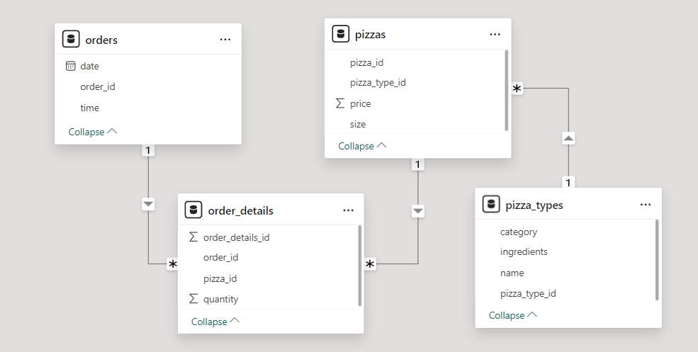
SCHEMA

Slide 4


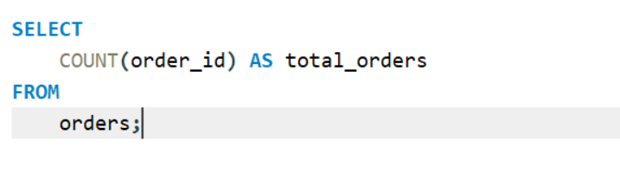
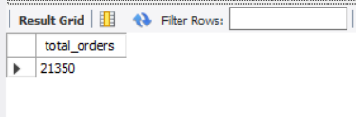
Retrieve the total number of orders placed.

Slide 5
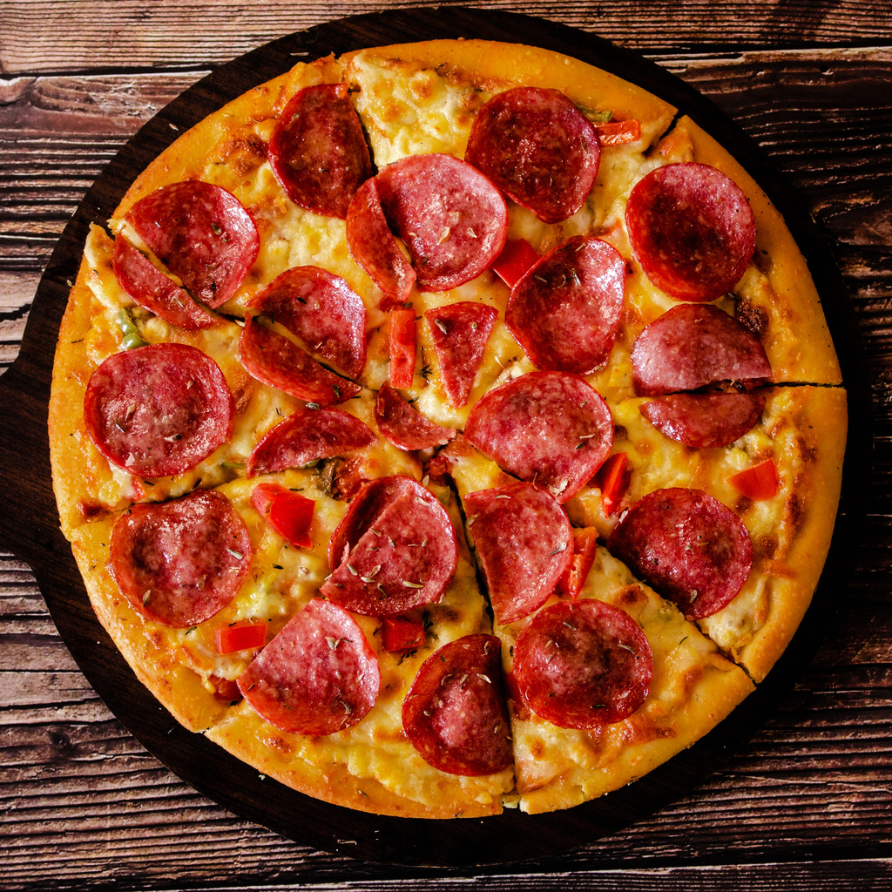

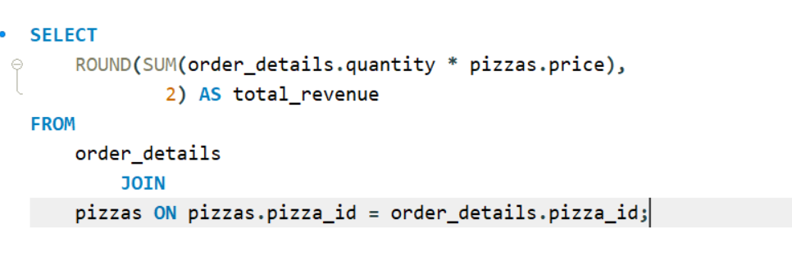


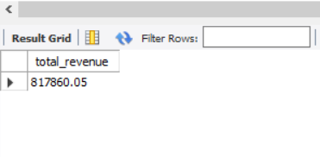
Calculate the total revenue generated from pizza sales.
$6
$6
$6
$6

Slide 6
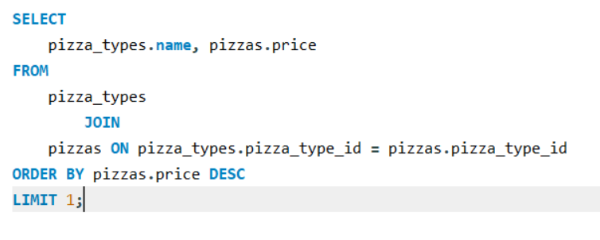
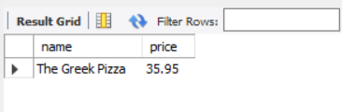
IDENTIFY THE HIGHEST-PRICED PIZZA.

Slide 7

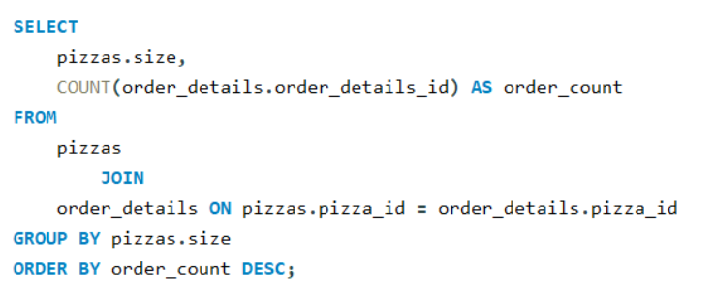
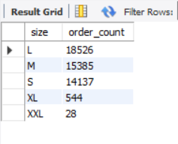
Identify the most common pizza size ordered.

Slide 8
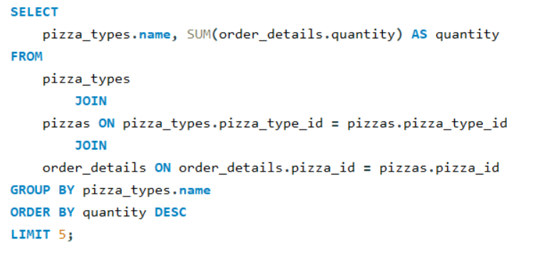
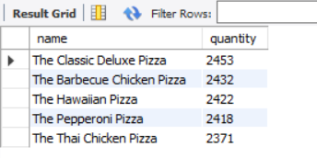
List the top 5 most ordered pizza types along with their quantities.

Slide 9

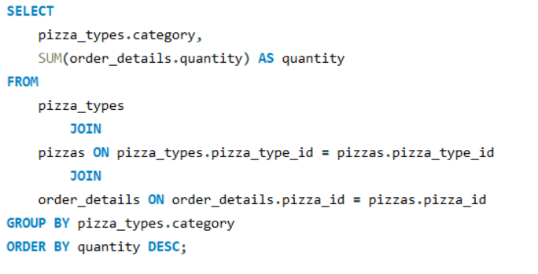
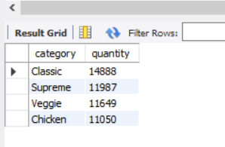
Join the necessary tables to find the total quantity of each pizza category ordered.

Slide 10
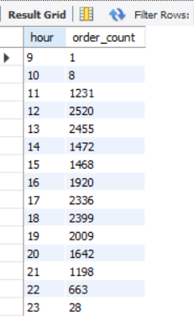
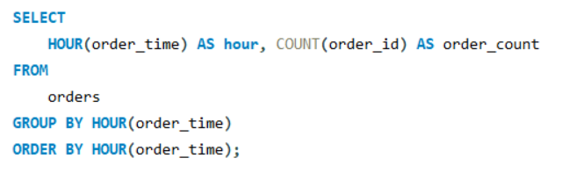
DETERMINE THE DISTRIBUTION OF ORDERS BY HOUR OF THE DAY.

Slide 11
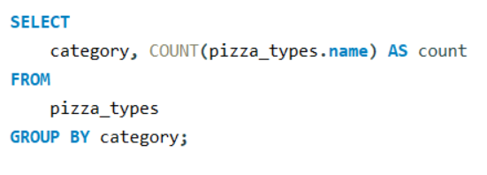
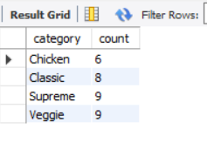
Join relevant tables to find the category-wise distribution of pizzas.

Slide 12
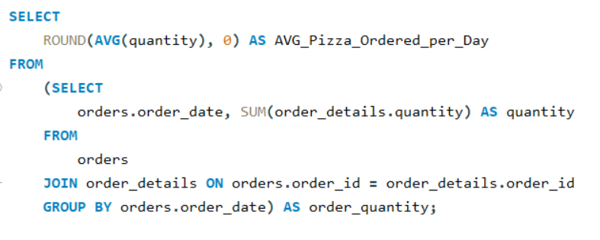
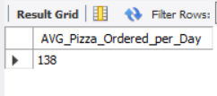
Group the orders by date and calculate the average number of pizzas ordered per day.
$6
$6
$6
$6

Slide 13
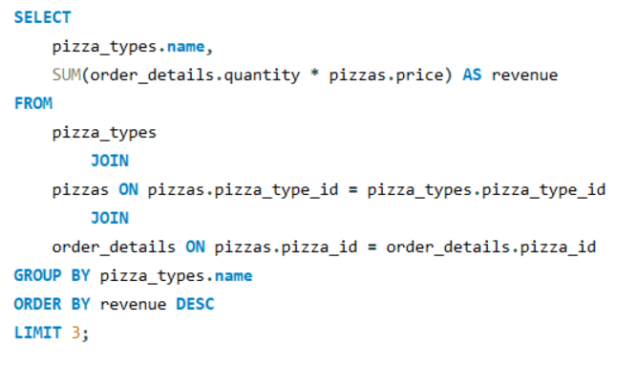
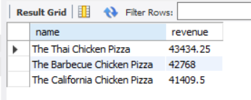
DETERMINE THE TOP 3 MOST ORDERED PIZZA TYPES BASED ON REVENUE.

Slide 14
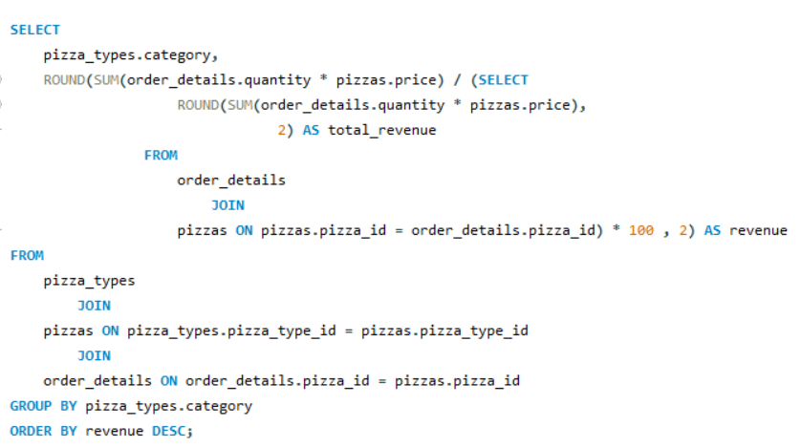
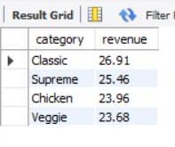
Calculate the percentage contribution of each pizza type to total revenue.

Slide 15
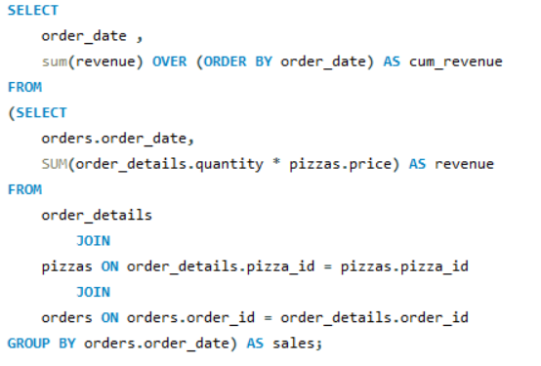
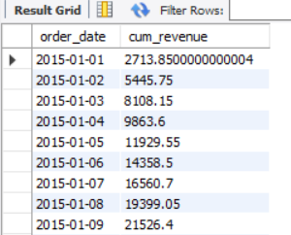
Analyze the cumulative revenue generated over time.

Slide 16
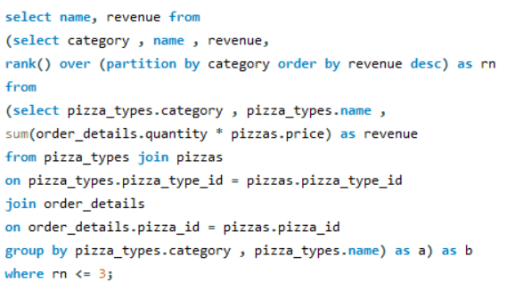
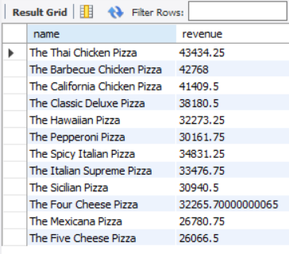
Determine the top 3 most ordered pizza types based on revenue for each pizza category

Slide 17


